Slide 1
Types of coupling
Control coupling and External coupling

Slide 2
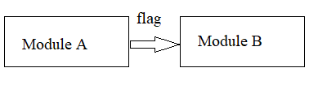
Types of coupling
Control coupling and External coupling:-
Two modules are control coupled if they communicate using at least one “control flag”.
Ex.when one class must perform operations in a fixed order, but the order is controlled else where
classMyclass
{
Public:
void doFirst(){}
void doSecond(){}
Void do(int option)
{
Switch(option)
{
Case 1 doFirst();
break;
Case 2:doSecond();
break;
Default:break’
}
}
Class x class
{
Public:
void call()
{
Do(x);
}
}

Slide 3
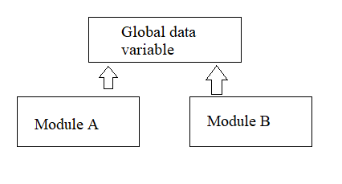
Problems: Bad coupling:-
Modules are not independent called module must known internal structure and logical of calling module.
4.External Coupling:-
A form of a coupling in which a module has a dependency to other module,external to the software being developed or to a particular type of hardware.
This is basically related to the communication to external tools and devices such as OS,shared libraries or the hardware.
Or external coupling occurs when two more modules access the same global data variable (not data structure)

Slide 4
Problem
1.High potential for side effects.
2.Missing access control.
3.Modules are bound to the global structure.
Ex calculate sales-tax
IF Product is sales exempt THEN
sales-tax=0 module A
ELSE
sales-tax=product-price*0.25
ENDIF
END

Slide 5
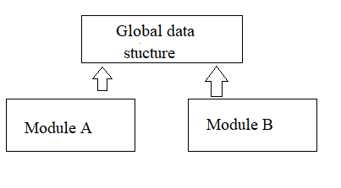
Calculate amount-due
Amount-due=totalamount+sales-tax module B
END
5.Common coupling
When multiples module have read and write access to some global data(data structure),it is called common or global coupling.
Ex two modules have access to same database and can both read and write same record. The both modules can access and change the value of global variable.
Usually poor design choice because
1.Difficult to reuse
2.Resulting code is unreadable, must read entire module to understand.
3.Difficult to determine all the modules that affect a data element (reduce maintainability)

Slide 6
6.Content Coupling:-
Two modules are content coupled if one module directly refer to the content of the other
Ex. One module changes a statement in another(LISP)
One module refers or alters data contained inside another module(Pascal)
One module branches into another module(Pascal)
Problem
Almost any change to one module requires change to another module if they one content coupled.

Slide 7
Thank you

